Slide 1
初识Blazor
张善友
Notes:
BETH TODO: Add a little context on what these “Focus” events are and that we’ll be bringing you more in the coming year….

Slide 2



张善友
首席架构师 | 资深.NET顾问和解决方案专家| 微软最有价值专家| 腾讯云最有价值专家| 华为云最有价值专家 | 超过20年的软件研发经验 | 曾在 腾讯工作11年 | .NET基金会成员
运营微信公众号“dotnet跨平台”和“移动开发和人工智能”，同时积极参与.NET社区开源项目，被尊称为张队长
张善友
微软SWAT特派专家
微软最有价值专家MVP
腾讯云最有价值专家TVP
华为云最有价值专家MVP

Slide 3
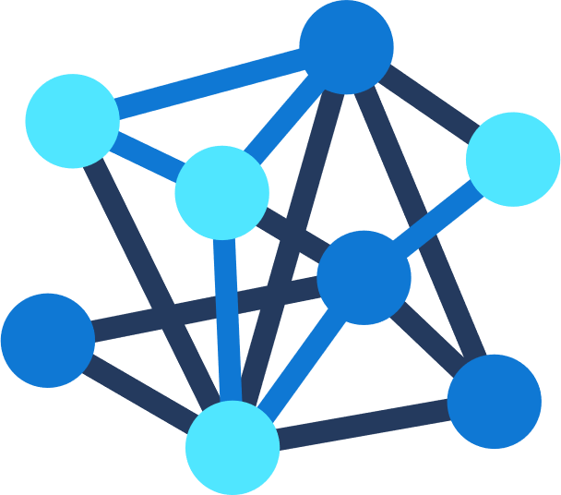

.NET
Your platform for building anything
Desktop
Web
Cloud
Mobile
Gaming
IoT
AI
Notes:
You can build anything with .NET.
We’ve made significant investments in .NET over the years as well as unifying the ecosystem to support building literally anything. From desktop to gaming to the cloud, .NET is a general purpose programming platform that enables all kinds of application scenarios. Once you learn one, you can easily pick up another.

Slide 4






前端发展历程
Webassmbly登场
2017
低代码/Low代码时代
2016
移动化时代来临
2014
前后端分离
全栈的演进
2013
工程化的开启
2008
结构+样式+行为分离
2003年

Slide 5
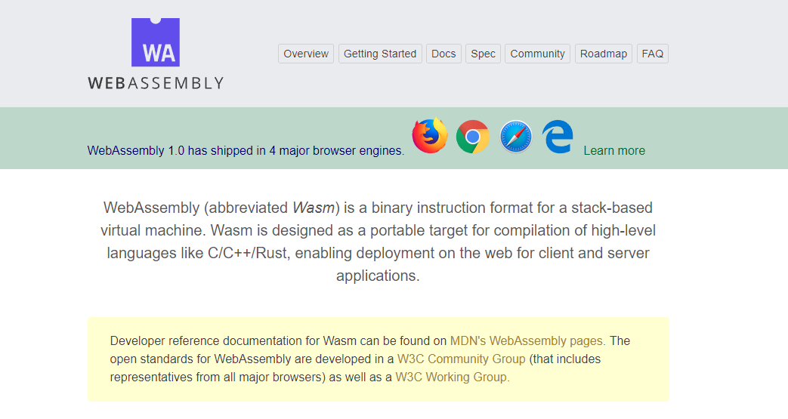

WebAssembly.org
文档: https://webassembly.org/docs/high-level-goals/

Slide 6









WebAssembly Working Group https://bit.ly/32yDOCP
Members from industry leaders:

Slide 7
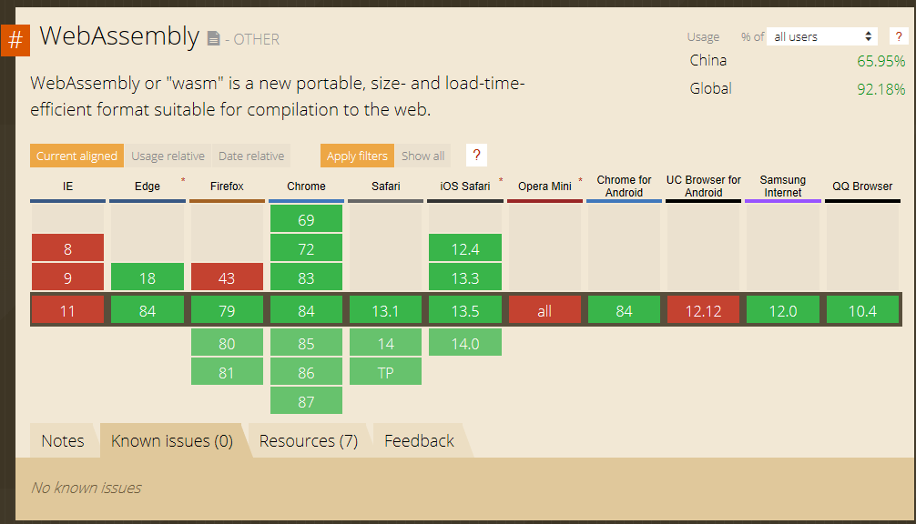
WebAssembly 兼容性
Source: https://caniuse.com/#search=wasm

Slide 8
Blazor 是什么?
Notes:
https://www.cnblogs.com/shanyou/p/12825845.html

Slide 9

.NET Core 3.1 & 5.0 Preview8
3.1 Long-Term Support (LTS)
Side-by-side support & self-contained EXEs
5.0 Preview8
Blazor: Full-stack web development with C# and Razor
Notes:
.NET Core 3.1 released last month so go get it!
We’ve added Windows Desktop support with Windows Forms and WPF support. This brings the capabilities of .NET Core to these UI frameworks. Particularly, flexible deployment with side-by-side and self-contained EXEs so you don’t have to have .NET installed on the machine first anymore.
We also have some exiting new things for Web developers with Blazor, which is what we’ll be talking about ALL DAY!, adding full-stack web development with C# and Razor, allowing you to build beautiful and responsive Single Page Apps without having to write JavaScript!
Additionally we have a ton of improvements for building better cloud native, scalable apps and services with ASP.NET as well as some exciting C# 8.0 language features.
<CLICK>

Slide 10






https://...
.NET
JS

Slide 11


Blazor
使用.NET 替代JavaScript构建 客户端web UI
使用 C# 和 Razor编写重用的web UI 组件
在客户端和服务端共享.NET代码
根据需要调用 JavaScript libraries & 浏览器 APIs
C#

Slide 12
Blazor 工作原理
Blazor Server
https...
ASP.NET Core
SignalR
DOM
Razor Components
.NET
.NET Core 3.1 LTS

Slide 13
Blazor 工作原理
Blazor WebAssembly
https://...
Razor Components
DOM
.NET
WebAssembly
Preview

Slide 14
共享组件模型
Blazor Server
Blazor WebAssembly
https...
https://...
ASP.NET Core
Razor Components
DOM
SignalR
DOM
.NET
Razor Components
WebAssembly
.NET
.NET Core 3.1 LTS
.NET Core 3.1 LTS
.NET 5

Slide 15

WebAssembly 工作原理
.NET Standard 2.1 构建
Delivered to browser
WASM alongside JS/HTML/CSS
MyBlazorClient.dll
MyBlazorClient.dll
JS
dotnet.wasm + Supporting files
dotnet.wasm + Supporting files
Referenced Assemblies
Referenced Assemblies
Referenced Assemblies
Referenced Assemblies
HTML
CSS
Referenced Assemblies
Referenced Assemblies

Slide 16




开始使用 Blazor
访问Blazor网站 https://blazor.net
安装 .NET Core 3.1
安装 Blazor WebAssembly 模板
Visual Studio
2019 16.4
Visual Studio for Mac
8.4
Visual Studio Code
+ C# extension

Slide 17
Blazor 实战
Notes:
Creating components
Using components
Component parameters
Routing
Layouts
Dependency injection
Event handling
Data binding
Forms & validation
Using .NET Standard libraries

Slide 18
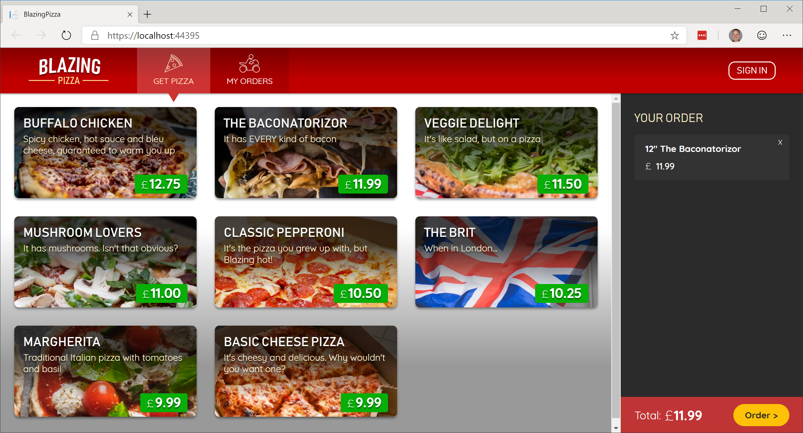
使用 Blazor 构建你的披萨网店界面
https://github.com/BlazorHub/blazor-workshop/tree/zhcn

Slide 19
Blazor Server 的扩展
测试活动的客户端交互延迟 (<200ms)
可用内存是主要瓶颈，不要每个用户加载几万条数据
实际应用行为将取决于应用内存使用情况、客户端行为和网络条件
利用 Azure SignalR Service
https://github.com/aspnet/AzureSignalR-samples/tree/master/samples/ServerSideBlazor
Instance size | Concurrent active users
Standard_D1_v2 (1 vCPU, 3.5 GB) | 5,000+
Standard_D3_V2 (4 vCPU, 14 GB) | 20,000+

Slide 20


那些公司已经在用Blazor 以及他们的评价…
“Pivotal is all about speeding up the path to production. That's why it invests in Steeltoe to provide its customers with a quick and easy way to build cloud-native .NET apps. And why we chose Blazor to create the Steeltoe website – Blazor makes it simple to design websites using C#.”
– David Dieruf, Product Marketing Manager, Pivotal Software
"We’re really impressed with .NET Core 3.1 and Blazor which has boosted our productivity, vastly improved the quality of our front-end code, and significantly reduced the amount of Javascript in our application to just 51 lines of code.“
– Matheus Guimaraes, Co-Founder & CTO at Deployed.

Slide 21


那些公司已经在用Blazor 以及他们的评价…
"We're extremely happy with Blazor as the UI for our broadcast TV equipment. Blazor server made it simple to render data from our hardware subsystems and we were able to rapidly develop a unified front-panel and remote UI for use on a range of products."
– Will Dean, Product Development Engineer, Videosys Broadcast
“BST Global is a leader in delivering innovative ERP and business management software solutions for the Architectural, Engineering and Consulting industry. We are currently exploring the use of Blazor technology with BST’s .NET Extensibility Platform and API to support its future web surface strategy because it keeps our developers more productive in C#.”
– Darren Johnson, Sr. Manager Software Engineering, BST Global

Slide 22
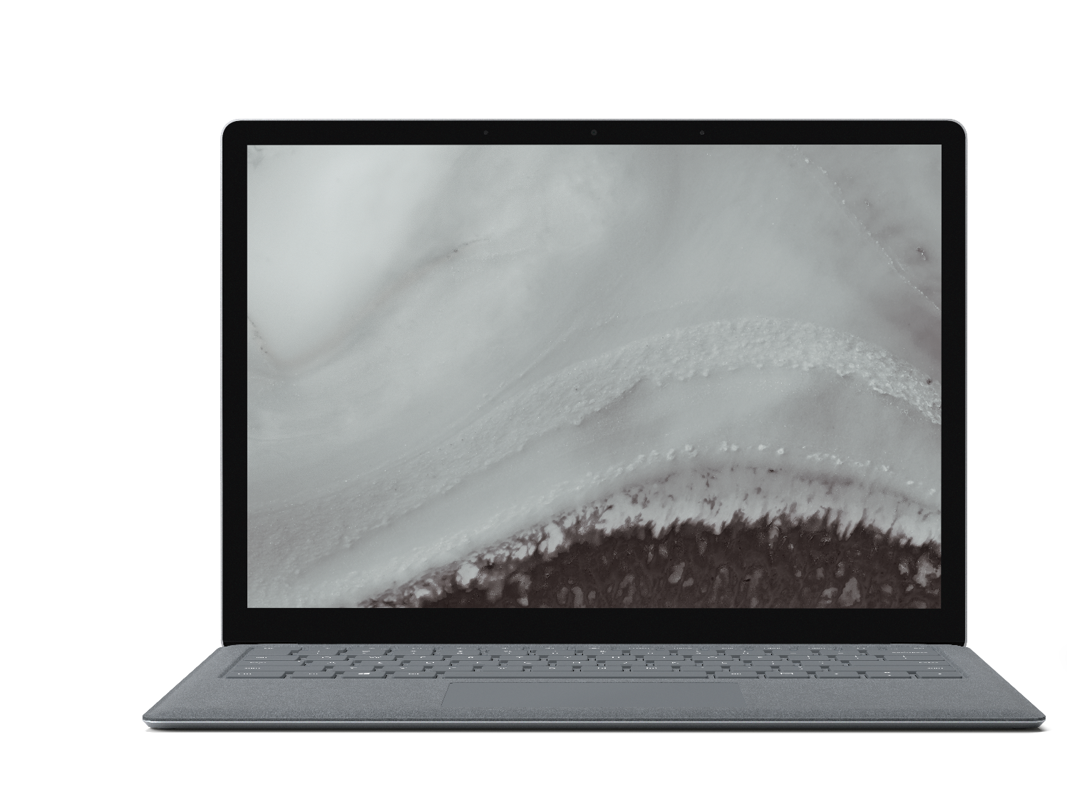

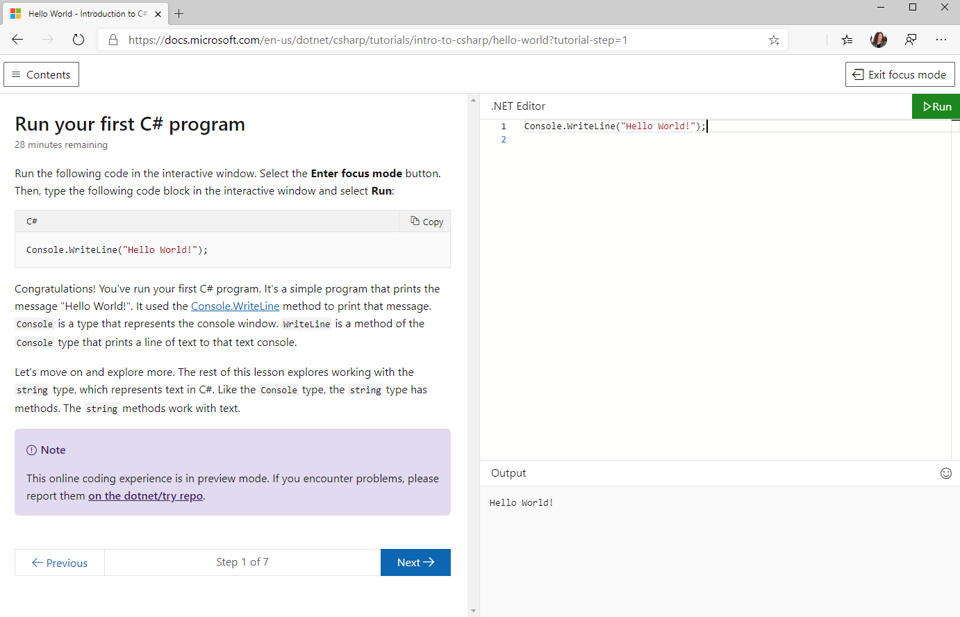
Try .NET
试一试在浏览器里跑 C# 和 .NET
使用 Blazor WebAssembly 在浏览器上本地运行代码，减少后端服务器压力
aka.ms/csharpintro

Slide 23
活跃的 Blazor 社区
https://aka.ms/awesomeblazor
开源免费的 组件 & JS 互操作 库
许多有趣的 Blazor 应用
文章, 视频, 博客, 和其他学习资料

Slide 24
Blazor Futures

Slide 25
Web
Blazor Server
Web app
Every interaction handled on server
Prerendered HTML (optional)
Blazor WebAssembly
Web app with client-side execution
Loaded from web server
Can work offline via Service Worker
Blazor PWA – OS installed
Appears as native app (own window)
Works offline or online
Blazor Hybrid
Native .NET renders to Electron / WebView
Appears as native app (own window)
Works offline or online
Desktop
+ Mobile
Blazor Native
Same programming model, but
rendering non-HTML UI

Slide 26
Blazor WebAssembly
2020 5.19 正式发布
初始版本基于.NET Core 3.1
模板会在 .NET Core 3.1 SDK 更新里面包含
这是属于当前版本, 不是长期支持版本
Blazor WebAssembly 已经进入.NET 5 并将随.NET 5的版本发布

Slide 27
Blazor WebAssembly 特性
.NET Standard 2.1
WebSockets + .NET SignalR client
Debugging (browser dev tools & Visual Studio)
Auto-rebuild
IL trimming
Brotli compression
Static web assets integration
Authentication options
Localization

Slide 28
Blazor Hybrid 实验
Blazor + Electron
https://aka.ms/blazorelectron
Blazor + WebWindow
https://aka.ms/webwindow
探索 Blazor Hybrid 场景也是.NET 5的一个主题

Slide 29
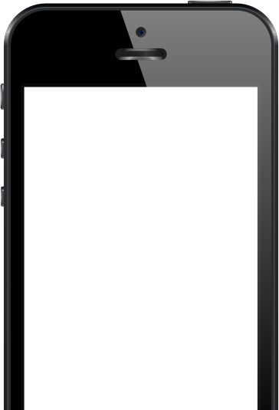

ANNOUNCING
Experimental Mobile Blazor Bindings
Build native mobile apps with Blazor
Use your familiar web skills: Razor, C#, CSS
Rich set of native mobile components
100% access to native APIs: GPS, Media, & more
Use existing ecosystem of NuGet libraries for mobile
All in .NET
aka.ms/mobileblazorbindings
Notes:
Use familiar web skills: Razor, C#, CSS
Rich set of native controls
Use the already vast ecosystem of .NET libraries for mobile
100% Access to Native APIs like GPS, sensors, bluetooth, media playback and media libraries, keyboard, and on and on
All in .NET (ie no req for other languages)
Powered by Xamarin
This is a first step in an experiment. To learn more, check out Eilon Lipton's session later today at 1pm PT. We hope you'll go hands-on with this and share your feedback.

Slide 30

.NET Schedule
May 2020
Blazor WebAssembly
Sept 2019
.NET Core 3.0
Nov 2019
.NET Core 3.1
LTS
Nov 2020
.NET 5.0
Nov 2021
.NET 6.0
LTS
Nov 2022
.NET 7.0
Nov 2023
.NET 8.0
LTS
.NET Core 3.0 released at .NET Conf in September
.NET Core 3.1 = Long Term Support (LTS)
.NET 5.0 release in November 2020
Major releases every year, LTS for even numbered releases
Predictable schedule, minor releases if needed

Slide 31
使用 Blazor WebAssembly 和 Visual Studio Code 生成 Web 应用
https://docs.microsoft.com/zh-cn/learn/modules/build-blazor-webassembly-visual-studio-code/

Slide 32
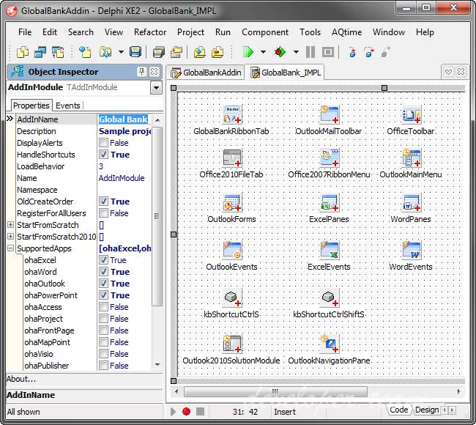
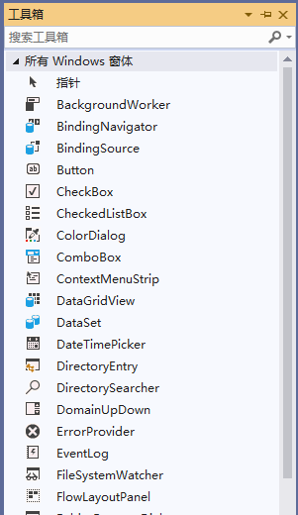
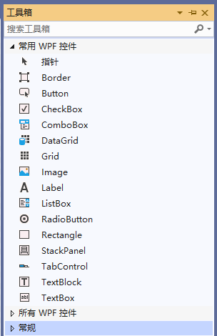
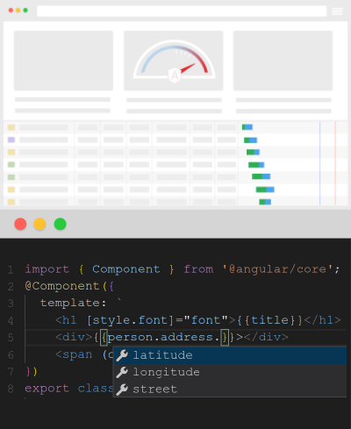


其他框架的组件(控件)
Delphi
WinForm
WPF
Angular
嵌套
属性
方法
事件
数据绑定
生命周期

Slide 33
Blazor创建组件的一些基本约定
Blazor中的组件正式称为 Razor 组件。
组件是使用 C# 和 HTML 标记的组合在 Razor 组件文件 (.razor) 中实现的。
组件类
组件的名称必须以大写字符开头。
例如，MyCool.razor有效，而 myCool.razor无效。
组件名称
通常组件的命名空间是从应用的根命名空间和该组件在应用内的位置（文件夹）派生而来的。
例如，应用的根命名空间是 BlazorSample，并且 Counter 组件位于 Pages 文件夹中：
Counter 组件的命名空间为 BlazorSample.Pages
组件的完全限定类型名称为 BlazorSample.Pages.Counter
命名空间

Slide 34
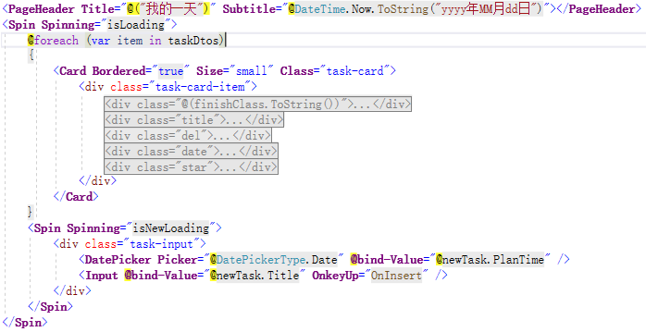
组件嵌套
Razor
Spin
Card
PageHeader
div
div-finish
Spin
div
DatePicker
Input
div-title
……

Slide 35
参数
属性使用 [Parameter]特性来声明属性为组件的参数
[Parameter]
public string Text { get; set; }
<Component Title=“文本">
属性使用 [CascadingParameter] 特性来声明属性是级联参数

Slide 36
数据绑定- HTML 元素
使用通过名为 @bind 的 HTML 元素特性提供了数据绑定功能
<p>
<input @bind="currentValue" /> Current value: @currentValue
</p>
@code {
private string currentValue;
}
绑定实现机制
<input value="@CurrentValue"
@onchange="@((ChangeEventArgs __e) => CurrentValue = __e.Value.ToString())" />
@code {
private string CurrentValue { get; set; }
}

Slide 37
数据绑定- Blazor组件
添加EventCallback<TValue>回调，并使用参数名加“Changed”后缀命名
@code {
[Parameter]
public int Year { get; set; }
[Parameter]
public EventCallback<int> YearChanged { get; set; }
}
使用时采用“@bind-参数名”的语法绑定父组件的属性和字段。
<Child @bind-Year="year" />

Slide 38
事件处理-HTML元素
对HTML 元素的事件采用@on{EVENT}格式（例如 @onclick）处理事件，Razor 组件将此属性的值视为事件处理程序。
<button class="btn btn-primary" @onclick="UpdateHeading">
Update heading
</button>
@code {
private void UpdateHeading(MouseEventArgs e)
{
...
}
}

Slide 39
事件处理-EventCallback
跨组件公开事件，可以使用 EventCallback。父组件可向子组件的 EventCallback 分配回调方法，由子组件完成调用。
子组件
<button @onclick=“OnClickCallback”>按钮</button>
@code {
[Parameter]
public EventCallback<MouseEventArgs> OnClickCallback { get; set; }
}
父组件
<ChildComponent OnClickCallback="@ShowMessage"></ChildComponent>
@code {
private void ShowMessage(MouseEventArgs e) { }
}

Slide 40
模板化组件
通过指定一个或多个 RenderFragment 或 RenderFragment<TValue> 类型的组件参数来定义模板化组件。
子组件
@typeparam TItem
<table class="table">
<thead>
<tr>@TableHeader</tr>
</thead>
<tbody>
@foreach (var item in Items)
{
<tr>@RowTemplate(item)</tr>
}
</tbody>
</table>
@code {
[Parameter] public RenderFragment TableHeader { get; set; }
[Parameter] public RenderFragment<TItem> RowTemplate { get; set; }
[Parameter] public IReadOnlyList<TItem> Items { get; set; }
}
父组件
<TableTemplate Items="pets">
<TableHeader>
<th>ID</th>
<th>Name</th>
</TableHeader>
<RowTemplate>
<td>@context.PetId</td>
<td>@context.Name</td>
</RowTemplate>
</TableTemplate>

Slide 41
生命周期
组件初始化
开始
设置参数前
SetParametersAsync
初始化
OnInitialized
OnInitializedAsync
设置参数后
OnParametersSet
OnParametersSetAsync
渲染呈现后
OnAfterRender
OnAfterRenderAsync
运行中
组件状态改变
父组件更改属性
设置参数前
SetParametersAsync
设置参数后
OnParametersSet
OnParametersSetAsync
当前组件状态改变
是否渲染
ShouldRender
false
StateHasChanged
true
渲染呈现后
OnAfterRender
OnAfterRenderAsync
运行中
组件销毁
运行中
销毁
Dispose
结束

Slide 42
数据交互流程
Client
Http
WebAPI
O/RM
Database
Blazor
HttpClient
Asp.net Core
EF Core
Sql Server

Slide 43
依赖关系注入（DI）
应用可通过将内置服务注入组件来使用这些服务。 应用还可定义和注册自定义服务，并通过 DI 使其在整个应用中可用。
跨多个组件共享服务类的单个实例
引用抽象将组件与具体服务类分离
服务
接口
依赖
依赖
依赖
实现
组件A
组件B
模块A
服务B

Slide 44
服务生存期
Scoped
Singleton
Transient
Blazor WebAssembly 应用当前没有 DI 范围的概念。 已注册 Scoped 的服务的行为与 Singleton 服务类似。
Blazor Server 应用中，服务注册的范围为“连接”。 因此，即使当前意图是在浏览器中运行客户端，对于范围应限定为当前用户的服务来说，首选使用 Scoped 服务。
DI 创建服务的单个实例。
所有组件都会接收同一服务的实例。
每当组件从服务容器获取 Transient 服务的实例时，它都会接收该服务的新实例。

Slide 45
总结
使用C# 和 .NET构建全栈Web开发
富组件模型和UI框架
ASP.NET Core 应用集成
Blazor Server 已经在 .NET Core 3.1 LTS ，可以用于产品开发
Blazor WebAssembly 3.2.1 已可以用于产品开发
可以尝试体验 Blazor Hybrid & Native
可以从 https://blazor.net 开始blazor之旅!

Slide 46
Blazor https://bit.ly/2xJbcIK
Blazor Components https://bit.ly/2LSJrWy
TONS OF BLAZOR RESOURCES https://bit.ly/2K9opyd
Blazor Workshop https://bit.ly/2LUJD7n

